Slide 1

Reading in KS2

Slide 2
Whole Class Reading
9-9.30 am all KS2 pupils participate in directed reading sessions 4x/week.
This is an opportunity for children to:
  Read every day and develop fluency through modelled reading, echo reading, paired reading, independent reading
  Explore and understand new Tier 2 vocabulary
  Learn how to answer a range of questions on a given text

Slide 3
Comprehension questions
Throughout KS2 and beyond, reading is assessed via written responses.
The questions posed cover a range of reading domains:
  Retrieval
  Sequencing
  Summarising
  Prediction
  Inference

Slide 4
Examples
Year 2

Slide 5
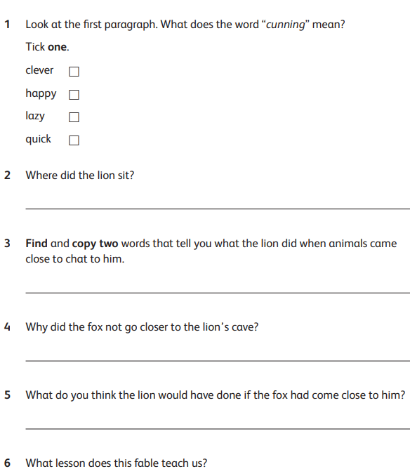

Slide 6
Examples
Year 4

Slide 7
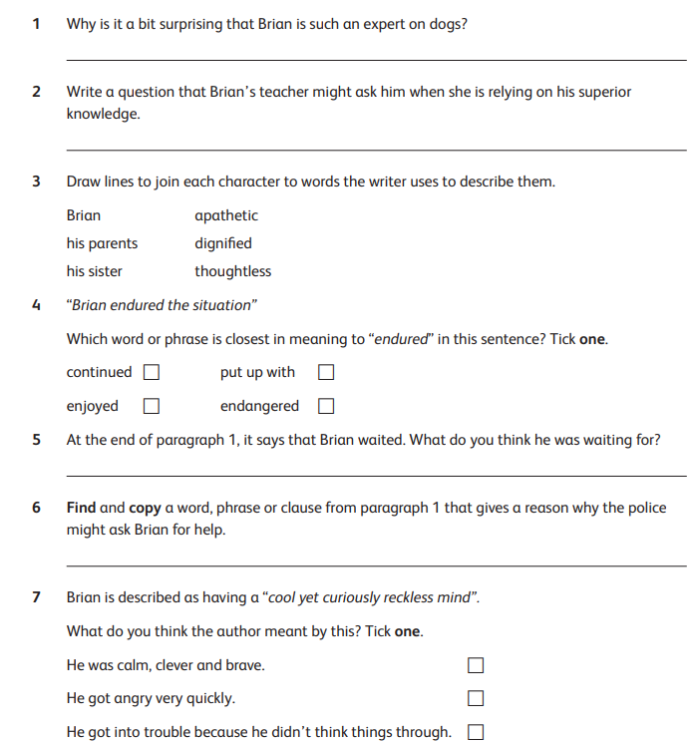

Slide 8
Examples
Year 6

Slide 9
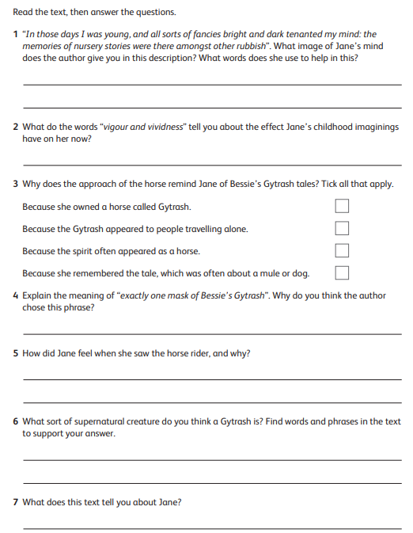

Slide 10
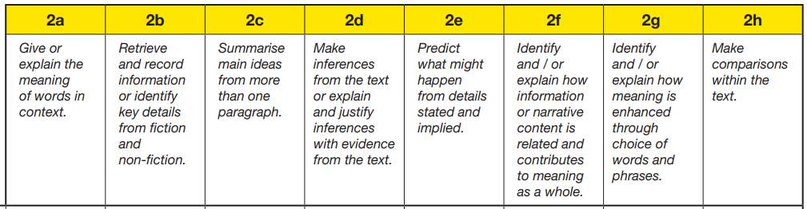
Examples
End of KS2 Reading SATs Paper 2024

Slide 11
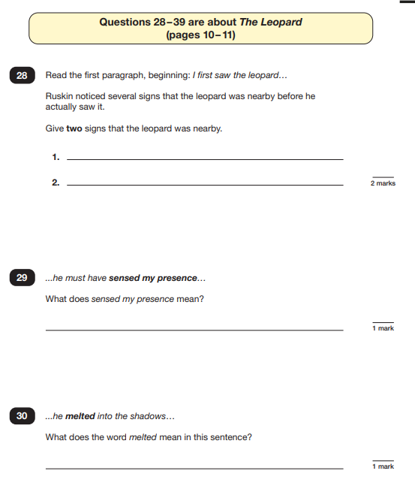
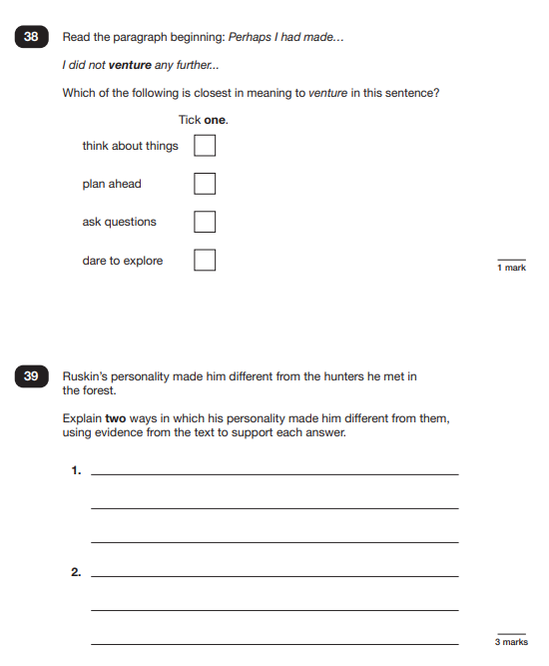

Slide 12



A love of reading

Slide 13
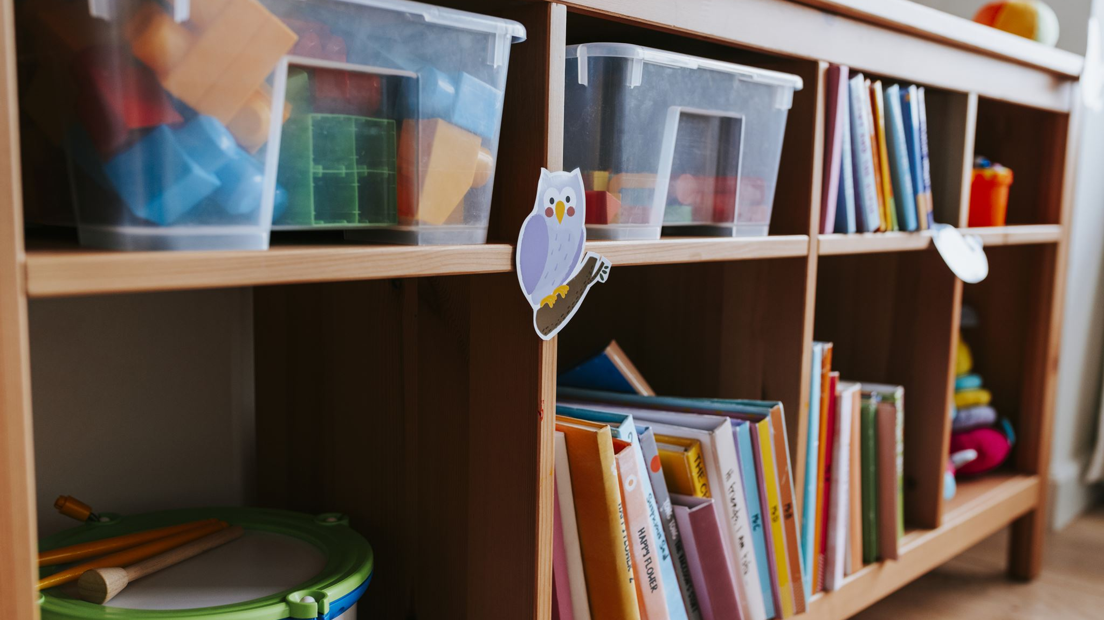

Promoting a love of reading

Slide 14
Promoting a love of reading
Developing an approach of “reading for pleasure” in classrooms
and reading areas. Book clubs, assemblies, World Book Day.
Daily story time in class.
Encouraging book talk, reviews and sharing.

Slide 15
Reading at Home

Slide 16
Supporting your child at home
This does not have to be their chosen book from school but one you may be reading together. It could be a book related to a non-fiction book related to a topic or your child’s interests.
We look at your child's reading diary each week and encourage reading at home at least 3 times a week. This will contribute to progress through their class reading challenge.
Audio books expose children to content, ideas and vocabulary.

Slide 17
It makes a huge difference…
Children who read for 20 minutes a day at home are exposed to 1.8 million words each year.
Reading with an adult expose children to a richer vocabulary and more sophisticated language structures. Studies show this can double a child's vocabulary, compared to children who read alone.
This boosts their reading and writing abilities, setting them up for success in school and life.

Slide 18
More than just reading…
Boosts Reading Comprehension
Discussing and asking questions helps deepen comprehension and build vocabulary of all children, including confident readers, leading to better academic performance across all subjects.
Improves Spelling and Writing
The interaction with adults helps children internalise spelling patterns and sentence structures, making them better writers.
Fosters a Lifelong Love of Reading
As well as being a positive, bonding experience, a passion for reading supported by reading at home can lead to higher academic achievement and greater success in life.

Slide 19
Strategies for Home Reading
Listening for fluency, intonation and recognition of punctuation.
Checking understanding of vocabulary.
Shared reading by taking turns to act as a model.
Some questioning to check understanding of text.

Slide 20
Any questions?

Slide 21
Thank you for your support

